Slide 1
Exceptions
Interrupts & Exceptions
Ich bin zu tiefst depressiv

Slide 2
Exceptions
Interrupts & Exceptions

Slide 3
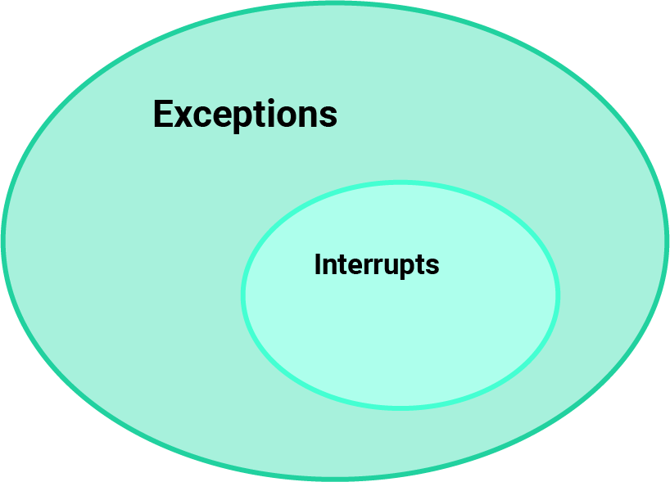
Exceptions

Slide 4
Exceptions / Interrupts
Exceptions
„Abnormale Interne Ereignisse“
Invalid Instruction
Illegal bus access
Interrupts
„Hardware Driven Signals“
External Signals
Peripheral Flags

Slide 5
Warum wollen wir Interrupts?

Slide 6
CPU
UART
ADC
Main
Program
TIMER

Slide 7
CPU
UART
ADC
Main
Program
TIMER

Slide 8
CPU
UART
ADC
Main
Program
TIMER

Slide 9
CPU
UART
ADC
Main
Program
TIMER

Slide 10
CPU
UART
ADC
Main
Program
TIMER

Slide 11
CPU
UART
ADC
Main
Program
TIMER

Slide 12
CPU
UART
ADC
Main
Program
TIMER

Slide 13
CPU
UART
ADC
Main
Program
TIMER

Slide 14
CPU
UART
ADC
Main
Program
TIMER

Slide 15
CPU
UART
ADC
Main
Program
TIMER

Slide 16

CPU
UART
ADC
Main
Program
TIMER

Slide 17
Interrupts
Analogie :D

Slide 18

Interrupts

Slide 19
CPU
UART
ADC
Main
Program
TIMER

Slide 20
CPU
UART
ADC
Main
Program
TIMER

Slide 21
CPU
UART
ADC
Main
Program
TIMER

Slide 22
Ablauf eines Interrupts

Slide 23
Ablauf eines Interrupts
CPU Speichert den aktuellen Kontext
CPU holt die Adresse des Interrupt-Service-Handler aus einer Vektortabelle
CPU springt zum Interrupt Service Handler
Interrupt Service Handler führt eine Operation aus
Interrupt Service Handler beendet sich
CPU stellen den Kontext wieder her

Slide 24
1.
CPU
Main
Program
Speicher

Slide 25
2.
CPU
Index | Adresse
0 | 0x20
1 | 0x24
2 | 0x28
3 | 0x2c
4 | 0x30
… | …
10 | 0x34
Main
Program
Notes:
0x20 - Reset
0x24 – Undefined Instruction
0x28 – Software Interrupt
0x2C – prefetch abort
0x30 – data abort
0x34 – reserved for future use

Slide 26
3. – 4.
Index | Adresse
0 | 0x20
1 | 0x24
2 | 0x28
3 | 0x2c
4 | 0x30
… | …
10 | 0x34
CPU
Main
Program
Ausführen des Codes
An 0x34
Notes:
0x20 - Reset
0x24 – Undefined Instruction
0x28 – Software Interrupt
0x2C – prefetch abort
0x30 – data abort
0x34 – reserved for future use

Slide 27
5.
CPU
Index | Adresse
0 | 0x20
1 | 0x24
2 | 0x28
3 | 0x2c
4 | 0x30
… | …
10 | 0x34
Main
Program
Notes:
0x20 - Reset
0x24 – Undefined Instruction
0x28 – Software Interrupt
0x2C – prefetch abort
0x30 – data abort
0x34 – reserved for future use

Slide 28
6.
CPU
Main
Program
Speicher

Slide 29
Ablauf eines Interrupts
CPU Speichert den aktuellen Kontext
CPU holt die Adresse des Interrupt-Service-Handler aus einer Vektortabelle
CPU springt zum Interrupt Service Handler
Interrupt Service Handler führt eine Operation aus
Interrupt Service Handler beendet sich
CPU stellen den Kontext wieder her

